Slide 1
A PLAYABAEL POWERPOINT Racing car game 02.V
A GMAE By: Skyland guard
Start!

Slide 2
rules
Go to the level page
To turn press the rolling oil dumpster and then press the right/left tringle
If your car touches the exploding you will have to press on the exploding

Slide 3
levels
Go back to the rules page
1

Slide 4


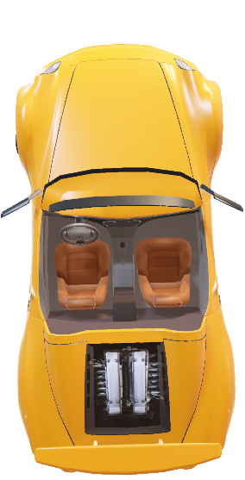
;
left!
Right!
U won!!

Slide 5

U lost!!!
Go back to the level page

